Slide 1
Invitation for Spring Run
Presentation by

Slide 2
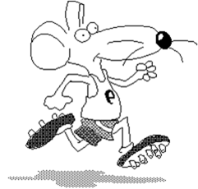
Spring Run
Start and finish: Sports ground
Date: 21 March
Time: from 10:00

Slide 3
Registration
In the town hall
daily between 8:00 and 15:30
by phone 22 550
by fax
online form on our web site
Deadline: 15 March
Entry fee: 10.00 for adults

Slide 4
Kids
1,000 m run
Start: 12:00
Course: Sports ground – primary school – sports ground
3,000 m run
Start: 13:00
Course: Sports ground – railway station – sports ground

Slide 5
Adults
5,000 m run
Start: 11:00
Course: Sports ground – railway station – castle – sports ground
10,000 m run
Start: 10:30
Course. Sports ground – castle – lake – sports ground

Slide 6
Marathon
Sports ground → railway station → castle → river bank → lake → town hall → sports ground

Slide 7
Special prizes! Lottery among all participants
?
?
?

Slide 8
Organisation
Max Gruber Management
Michelle Kramer
Anna Wilson

Slide 9
Training
Each Friday, 18:00
Meeting point: Sports ground
Choose your training level
Experienced coach there to help you

